Slide 1
Air Gap Systems
A WAY to secure our data

Slide 2
Table of Contents
Introduction
What are air gap systems?
Usage of air gap systems
Flaws of air gap systems
conclusion

Slide 3
Introduction

Slide 4

Introduction
“Ransomware is expected to attack a business every 11 seconds by the end of 2021,”
says a report by Cybersecurity Ventures.

Slide 5

Introduction
The cost of damages due to system security breaches is projected to cost over $6 trillion by 2021.
Because of these threats, many organizations are now choosing to have air-gapped computers or networks.

Slide 6
What are air gap systems?

Slide 7

What are air gap systems?
Air-gap refers to computers or networks that are not connected directly to the internet or to any other computers that are connected to the internet.

Slide 8
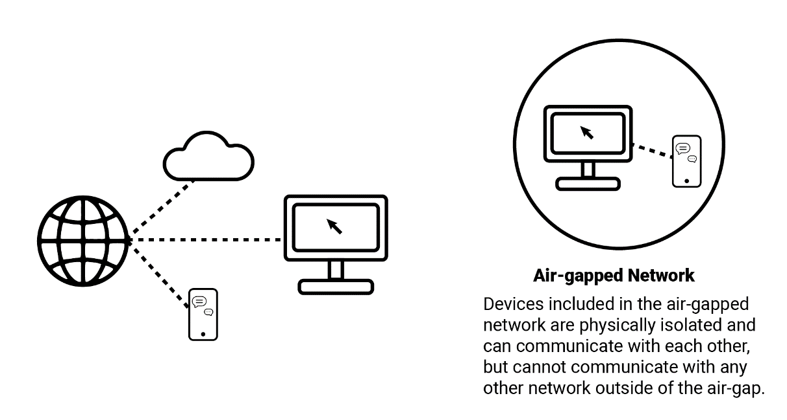
What are air gap systems?
A true air gapped computer is also physically isolated, meaning data can only be passed to it physically (via USB, removable media or a firewire with another machine).

Slide 9
Usages of air gap systems

Slide 10
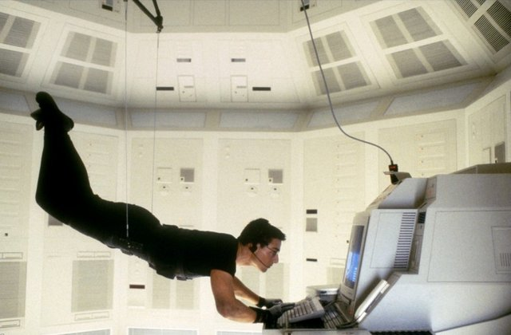
Usages of air gap systems
Do you remember the scene from the movie Mission Impossible where Tom Cruise rappels down from the ceiling?
It’s one of the most famous scenes in movie history. In it, Cruise lowers himself from an air vent and dangles just feet above the floor as he steals a list from a computer in FBI headquarters.
That is an air gapped computer.

Slide 11
Usages of air gap systems
Air gaps generally are implemented where the system or network requires extra security, such as classified military networks, the payment networks that process credit and debit card transactions for retailers, or industrial control systems that operate critical infrastructure.
Also in :
Life-critical systems such as Medical Equipment
Nuclear power plants
Aviation Computers
Government computer systems and networks

Slide 12
Flaws of air gap systems

Slide 13
Flaws of air gap systems
Are air gapped computers completely secure?
No. At least not from Tom Cruise. ☺

Slide 14
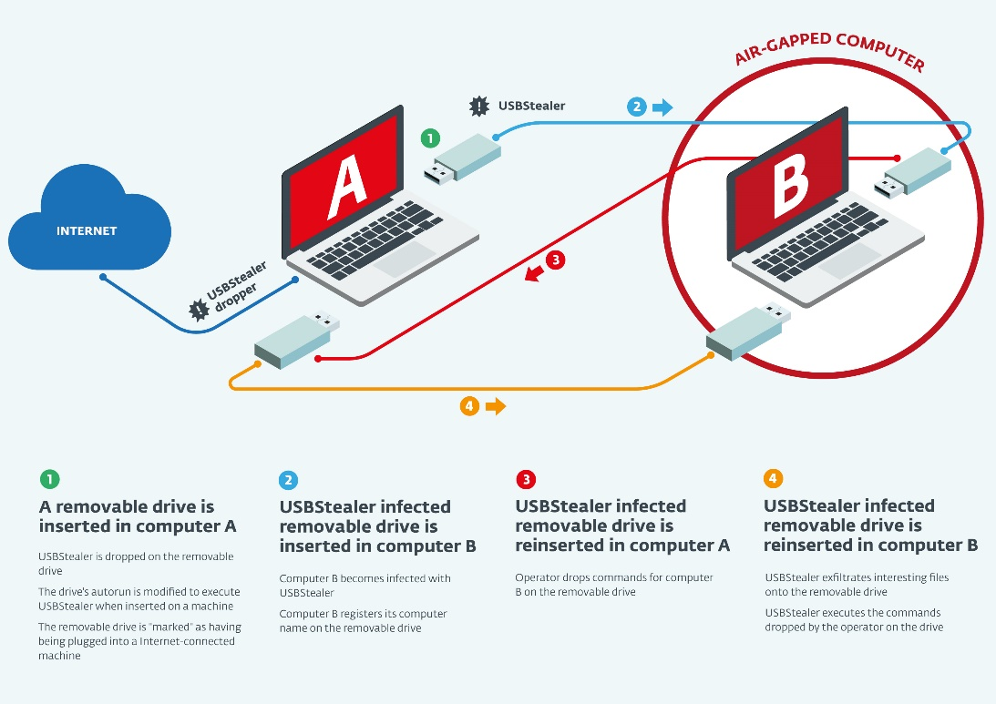
Flaws of air gap systems
Seriously though, while you definitely don’t need to freak out and go find an alternative to air gapping, it would be silly to pretend that nothing can go wrong. Air gapped computers can still be breached. Granted, it’s a hell of a lot harder to do when a computer is air gapped, but methods exist.

Slide 15
The easy way to breach an air gapped computer
Social engineering. That’s right, the easiest way to breach an air gapped computer is to find a human intermediary to wittingly (or possibly unwittingly) breach the computer. To do this they will need to access the computer themselves and attach a USB device like a flash drive or a Wi-Fi dongle.
That’s the easiest way.

Slide 16
Other ways to breach air gapped computers
If you want to get a bit more scientific, there are other way channels to extract data from an air gapped computer, they include:
Electromagnetic (EM)
Acoustic
Thermal
Optical

Slide 17
Stuxnet, the most famous infection of air gap systems
One of the most famous cases involving the infection of an air-gapped system is Stuxnet, the virus/worm designed to sabotage centrifuges used at a uranium enrichment plant in Iran. Computer systems controlling the centrifuges were air-gapped, so the attackers designed Stuxnet to spread surreptitiously via USB flash drives. Outside contractors responsible for programming the systems in Iran were infected first and then became unwitting carriers for the malware when they brought their laptops into the plant and transferred data to the air-gapped systems with a flash drive.

Slide 18
Conclusion

Slide 19
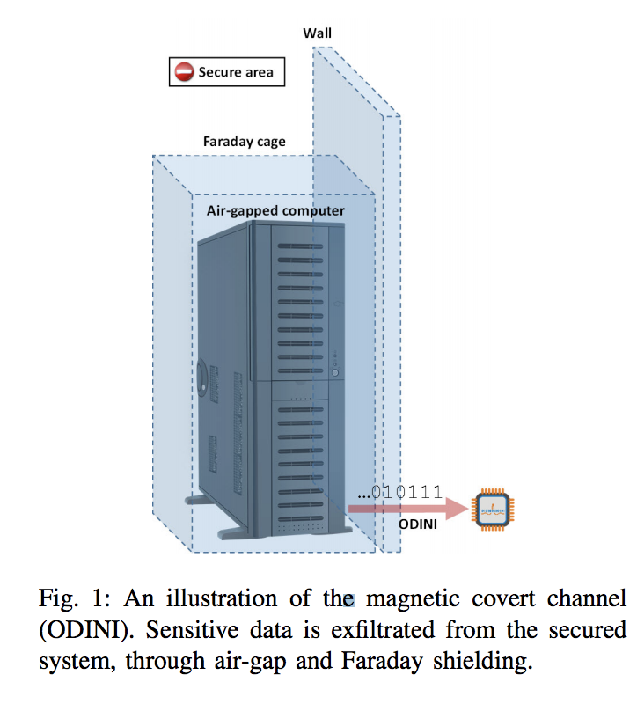
Conclusion
In theory, air-gapped networks seem like a great idea. In practice, it’s another story.
So if you or your business use an air-gapped system, you must assess or monitor your network to sure your system is correctly air-gapped. Monitoring includes looking for new data coming in from removable media, transient devices, or external network connections being set up with modems or VPNs.
And Also, you should not neglect social engineering.

Slide 20
The end

Slide 21
Air-gap network = شبکه شکاف هوا
Network security = امنیت شبکه
WIFI ( wireless network interface controller ) = کنترل کننده رابط شبکه بی سیم
Network administers = مدیران شبکه
Breaches = نقض
Sophisticated attackers = حمله کنندگان خبره وماهر
Network architecture = معماری شبکه
Aviation Computers = رایانه های هواپیمایی
Social engineering = مهندسی اجتماعی (امنیت)
FM radio receiver ( medium frequency )
VPN ( virtual private network ) = شبکه خصوصی مجازی

Slide 22

Thanks for your attention
Amir Mohammad babaee
Amir hosein Najafi Zadeh

